Slide 1
State of a component

Slide 2
Component State
JavaScript Object
Describes the current state of the component
  Data, UI State
The state of the component can be updated over time
  The modal could close
  The data we output could change
The state of component is mutable.

Slide 3
Component State
Example: Shopping cart
{
Items : [
{name: ‘jacket’, size:’L’},
{name: ‘Jersey’, size:’M’},
]
}

Slide 4
Component State
We can update the previous state by adding items to the cart.
Example: {
Items : [
{name: ‘jacket’, size:’L’},
{name: ‘Jersey’, size:’M’},
{name: ‘Shoes’, size:’9’}
]
}

Slide 5
Component State
Another Example:
{
showPopUp: true
}
{
showPopUp: false
}

Slide 6
Recap on Virtual DOM

Slide 7
Currently our App Structure
-> Constantly Updating
-> Container & UI
App.js
Props(infos)
DeleteInfo
AddInfo
Display.js
AddForm.js

Slide 8
Behind The Scenes of Updating
UI Component
Display.js
BROWSER
DOM
JSX
VirtualDom
(New)
VirtualDom
(Current)
Difference Updated

Slide 9
How to use CSS in React
Click this to know more

Slide 10
Lifecycle of a Component

Slide 11
Four phases of a React component
Initialization
Mounting
Update
Unmounting

Slide 12
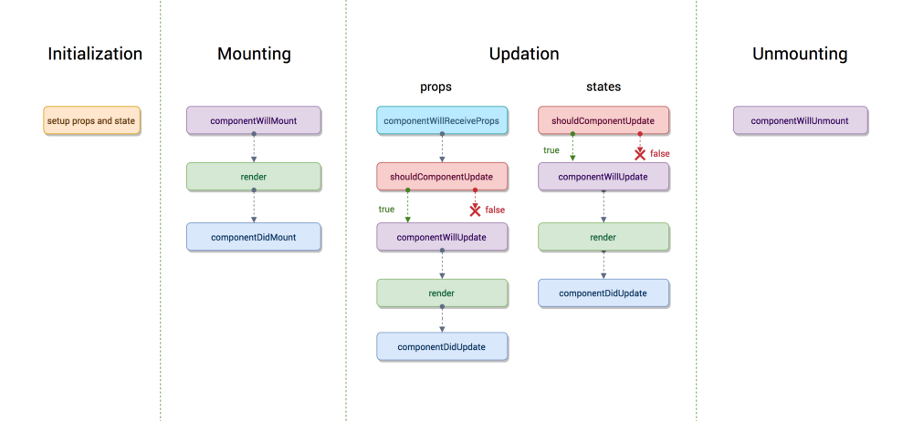
Phases Of React Component

Slide 13
Interactive Lifecycle hooks

Slide 14
React Routing

Slide 15
Routing
/home
App.js
Initial Request
Server
Home.js
Component
index.html
Response

Slide 16
Routing
/about
Browser
Server
About.js
Component
React

Slide 17
Higher Order Components
HOC
Supercharged Component
Component
Navbar.js
Navbar.js
Navbar.js

Slide 18
Website Requirements
For our website
Grab data to dynamic for usage
These data can be from some self created REST api on your server
OR
Third party REST api.
We will use some fake user json api. -> we use the end points to get the data from the api
Ex: https://jsonplaceholder.typicode.com/posts → will fetch us the posts data from the api
So we will grab this data.
Link to that api is : https://jsonplaceholder.typicode.com/

Slide 19
Promise Object
A promise is an object that may produce a single value some time in the future:
either a resolved value, or a reason that it's not resolved (e.g., a network error occurred).
Promises are eager, meaning that a promise will start doing whatever task you give it as soon as the promise constructor is invoked.

Slide 20
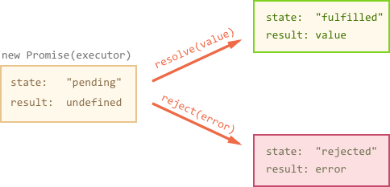
Promise Object

Slide 21
Axios
We need Axios because :
It’s is a popular, promise-based HTTP client that sports an easy-to-use API and can be used in both the browser and Node.js.

Slide 22
What’s these HTTP client
Making HTTP requests to fetch or save data is one of the most common tasks a client-side JavaScript application will need to do.
Third-party libraries — especially jQuery — have long been a popular way to interact with the more verbose browser APIs, and abstract away any cross-browser differences.
As people move away from jQuery in favor of improved native DOM APIs, or front-end UI libraries like React and Vue.js, including it purely for its $.ajax functionality makes less sense.

Slide 23
Route Parameters
Part of URL that can change.
Usually see them on URLs for individual records
User Profile Route:
mysite.com/users/user1
mysite.com/users/user2
Blog posts
myblog.com/post/1234
myblog.com/post/3456

